Slide 1


Capitalization Notes on People and Culture

Slide 2
Capitalization
A. People’s names and initials.
Ex: Sandra Smith
President Bill Clinton
John F. Kennedy

Slide 3
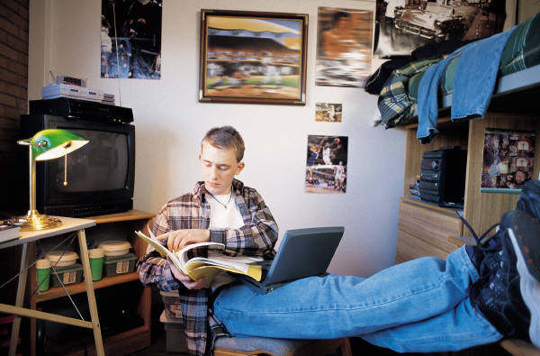
B. Titles and abbreviations of titles that are used before names or direct address.
Ex: Senator John Smith
Rev. James L. Nash
Do you need me to clean my room, Mom?

Slide 4
C. Titles of heads of state, royalty, and nobility -ONLY when they are used before a person’s name, or in place of their name.
Ex: Surgeon General David Smith
Justice O’Connor
Queen Elizabeth
Note: Do NOT capitalize titles when they are used without a proper name.
Ex: The duchess opened the ceremony.

Slide 5
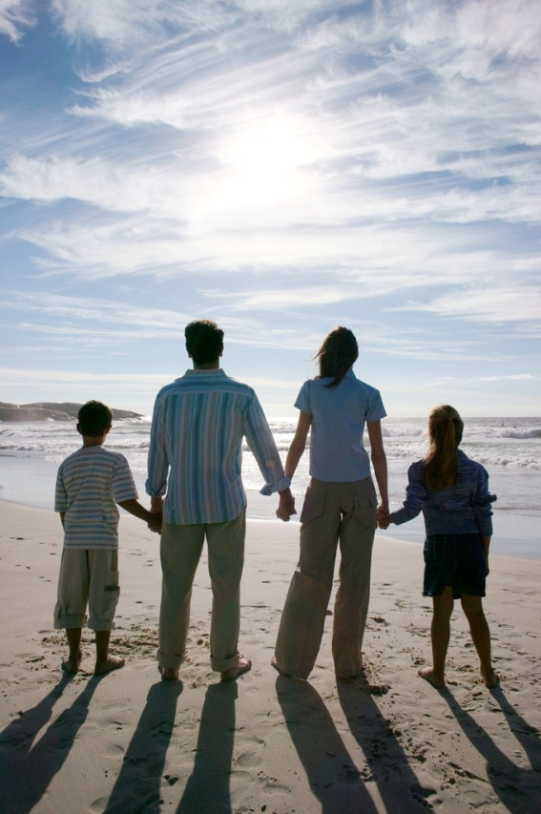
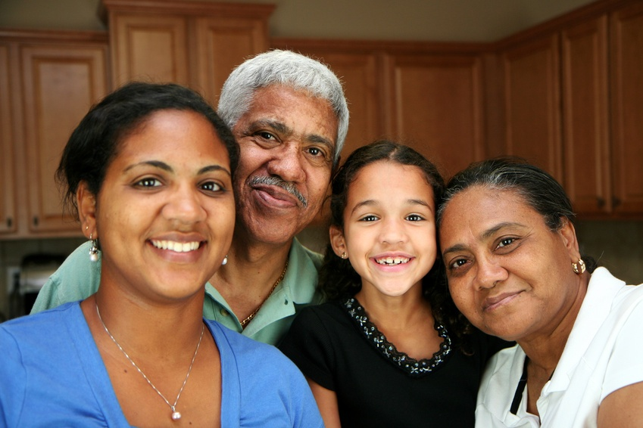
D. Words indicating family relationships only when they are used as names or before names.
Example before names: Aunt Laura
Cousin David
Uncle Al
Example of family used as a name: I want Mother to pick me up from school today.

Slide 6
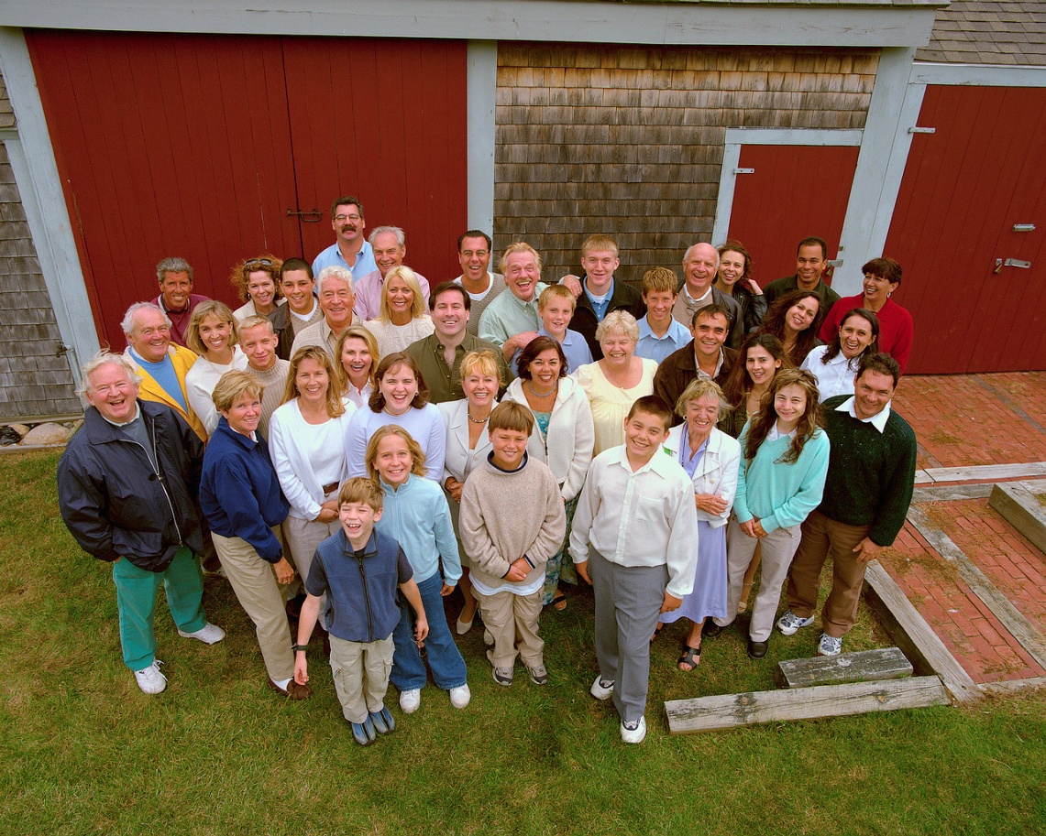
E. Always capitalize the pronoun I!!!!!!
Ex: Mother informed me that I was named after Uncle Henry.

Slide 7
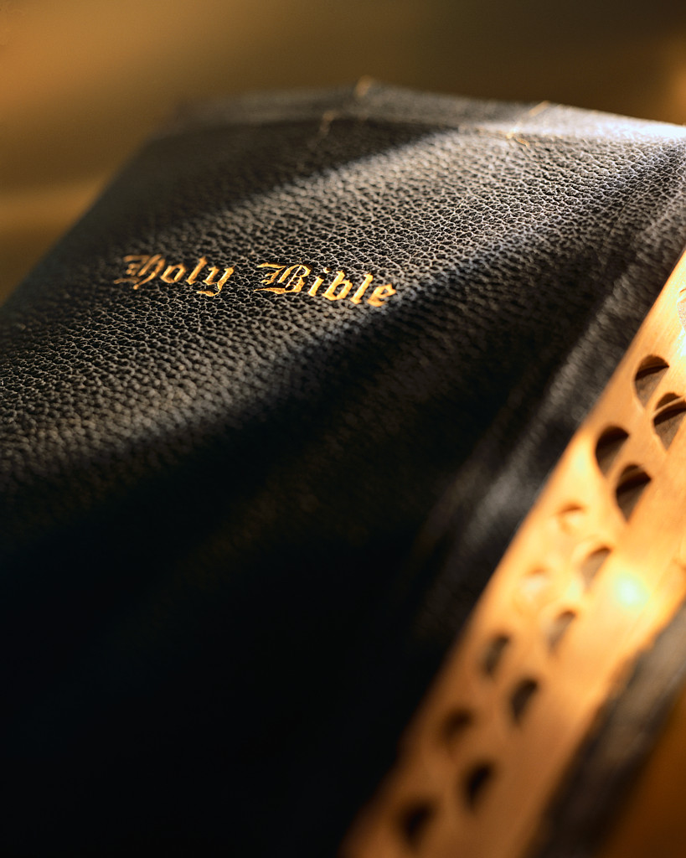
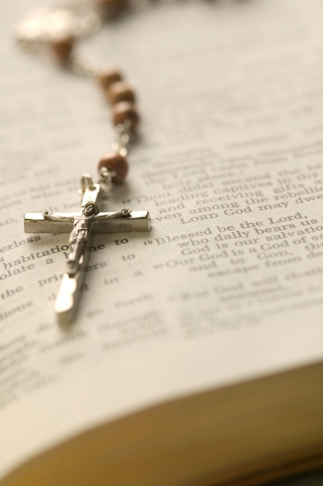
F. Capitalize the names of religions, sacred days, and sacred writings.
Ex: Christianity
Good Friday
Easter
Bible
God

Slide 8
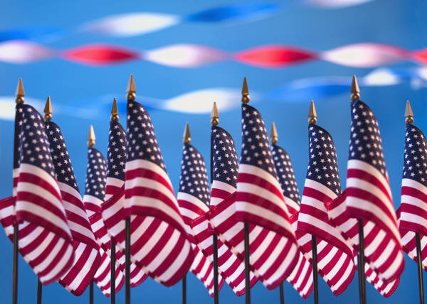
G. Nationalities, languages, races, and most ethnic groups, and the adjectives formed from these names.
Ex: German
Spanish
Korean
European
English
American

Slide 9
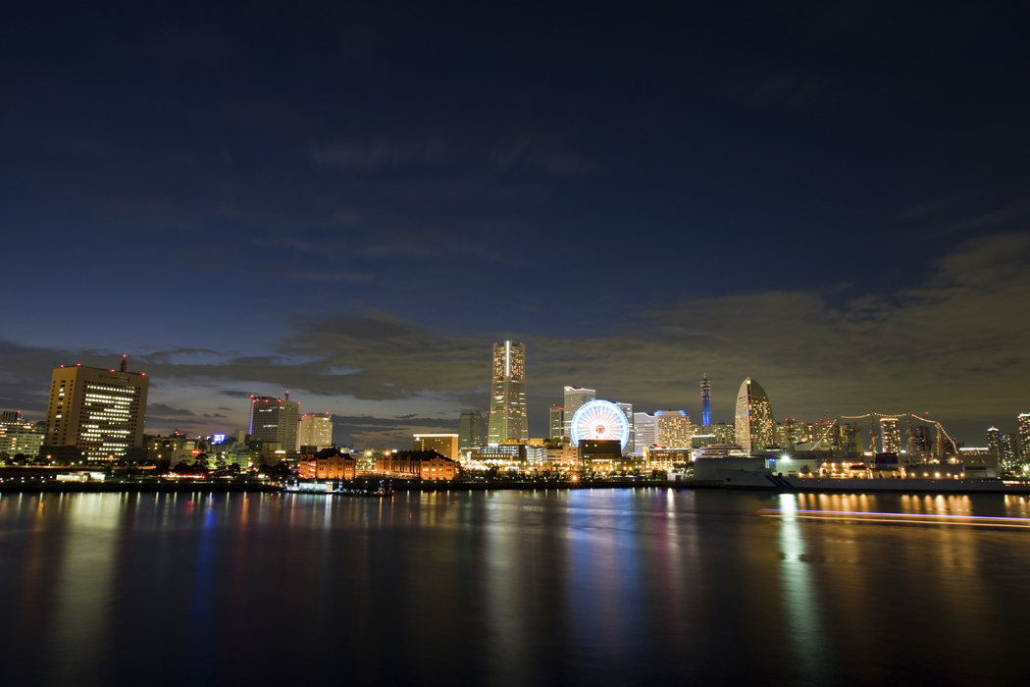
Sentences and poetry:
A. Capitalize the first word in every sentence.
Ex: My pen pal from Japan is named Susie.

Slide 10
B. In traditional poetry, capitalize the first word of every line.
Ex: All that glitters is not gold,
Not all those who wander are lost

Slide 11

Capitalization of Quotations
C. Capitalize the first word of a direct quotation.
Ex: “Please copy down the notes, class,” said Mrs. Hayre.

Slide 12
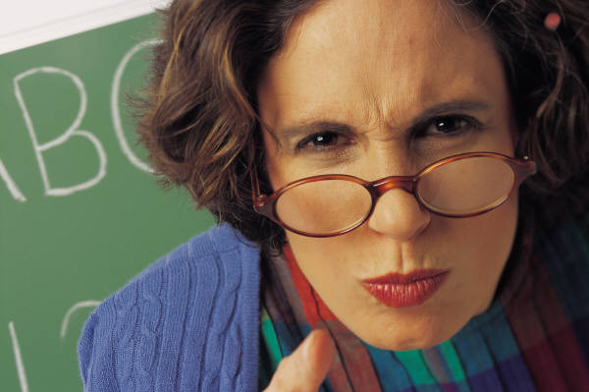
Capitalization in Quotations
In a divided quotation, do not capitalize the first word of the second part unless it starts a new sentence.
Ex: “Copy down your notes, students,” said Ms. Sasser, “you will be having a quiz over them.”

Slide 13
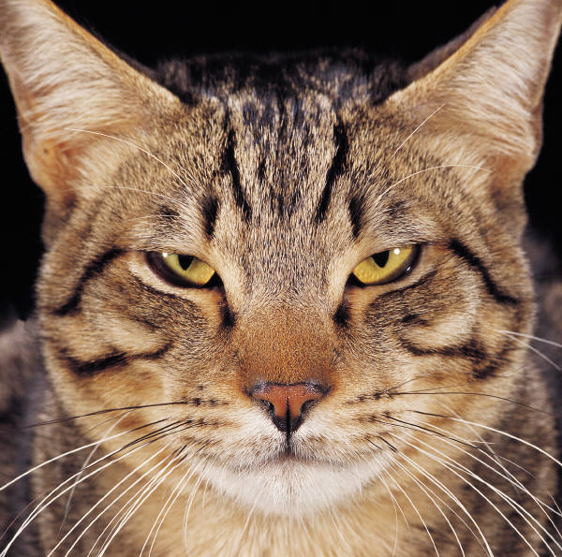
Outlines
D. Capitalize the first word of each entry in an outline and the letters that introduce sections.
Ex: I. Types of felines
A. Domesticated cats
1. Persian
2. Tabby

Slide 14

Parts of a Letter
E. Capitalize the first word in the greeting and in the closing of a letter.
Ex: Dear Mr. Hensley,
Dear Sir:
Sincerely yours,
Yours truly,
Love always,

Slide 15
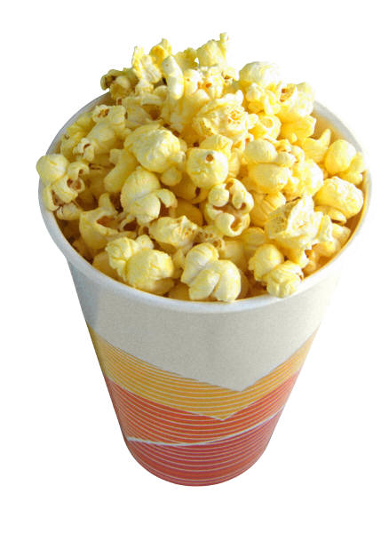

Titles of Media- Movies, Books, Plays, Musicals, Short stories, Poems, Magazines and Newspapers, T.V. Shows, Works of Art, Games.
F. Capitalize the first word, last word, and all important words in a title. Don’t capitalize words that are 3 letters or less.
Ex: Prince of Egypt
Robin Hood, Prince of Thieves
Island of the Blue Dolphins

Slide 16
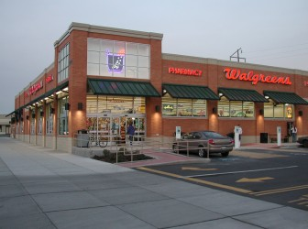
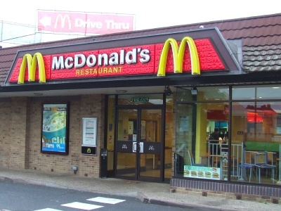
Capitalization
Organizations and Other Subjects

Slide 17
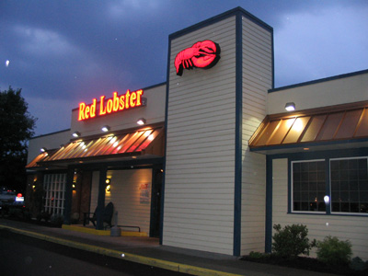

AA. Capitalize all important words in the names of organizations, institutions, stores, and companies.
Examples:
North Laurel Middle School
National Honor Society
League of Nations
Wal-Mart
Shiloh Road House

Slide 18
B. Historical time periods and events
Examples:
Harlem Renaissance
Revolutionary War
Space Age

Slide 19
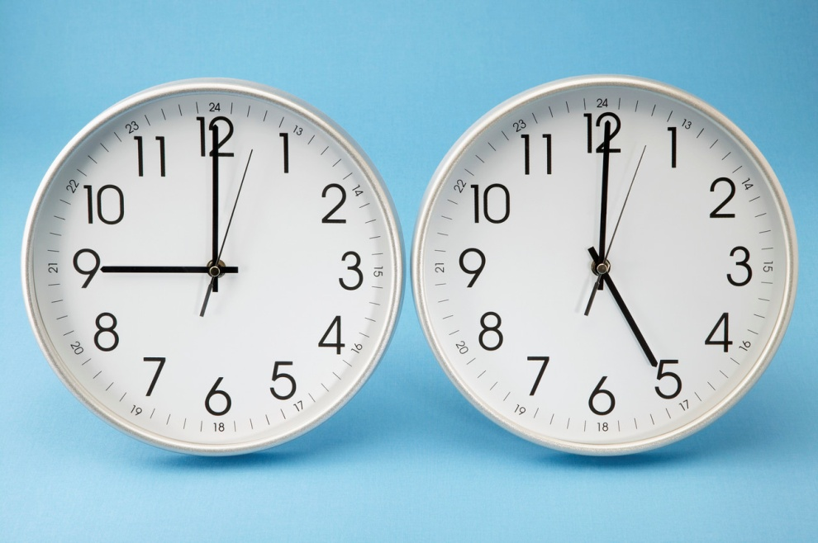
C. Capitalize Abbreviations
Examples:
Time is abbreviated by a.m., and p.m.
Time periods such as B.C.

Slide 20

D. Names of months, days, and holidays
E
Examples: October, Labor Day, Halloween, Easter, St. Valentine’s Day, Monday, Friday
Do NOT capitalize seasons such as spring and fall

Slide 21
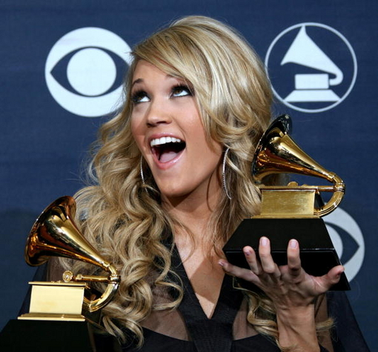

E. Capitalize special events and awards
Examples: World Series, Grammy Awards, Caldecott Medal

Slide 22
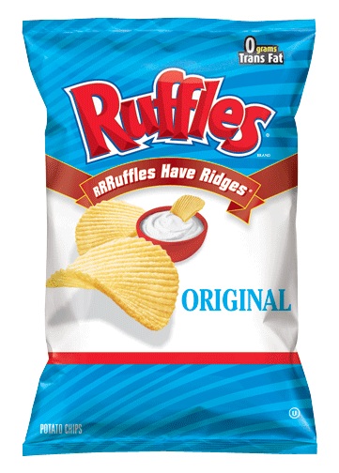
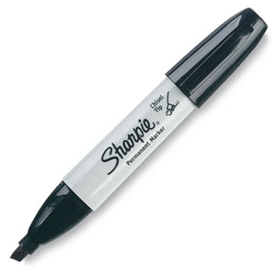
F. Capitalize the brand name of a product, but not the common noun that follows a brand name.
Examples: Sharpie markers
Ruffles potato chips

Slide 23
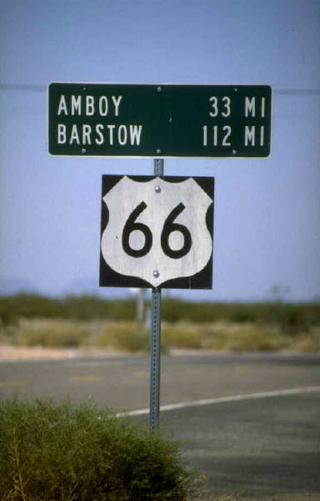
Places and Transportation
A. In geographical names, capitalize each word except articles and prepositions. (These include: Divisions of the world, Continents, Bodies of Water, Islands, Mountains, Other Landforms, Regions, Nations, States, Cities and Towns, Roads and Streets)
Ex: Strait of Magellan, Sahara,
Spain, New York, Indian Ocean, Route 66, Fifth Avenue

Slide 24
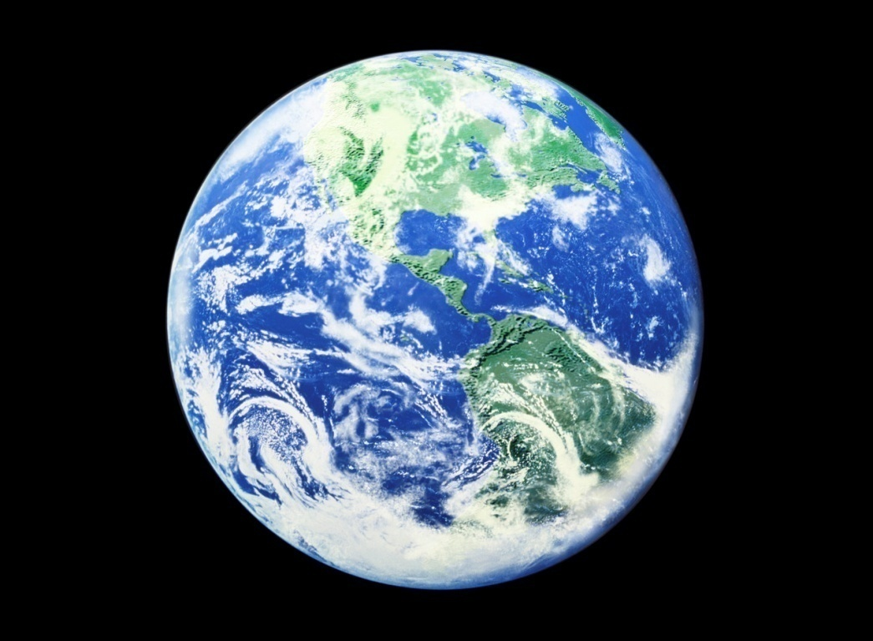
Places and Transportation
B. Names of planets and other specific objects in the universe.
Ex: Mercury, Saturn, Andromeda, Big Dipper, Ganymede

Slide 25

Places and Transportation
C. The words north, south, east, and west when they name particular regions of the United States.
Example: Some states in the Southeast were named after British royalty.
DO Not capitalize general directions:
The state of Kentucky is south of Ohio.

Slide 26
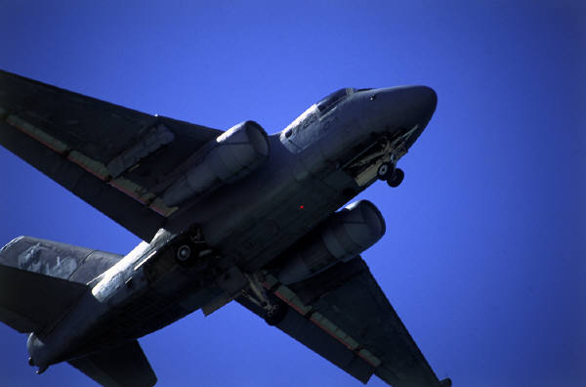
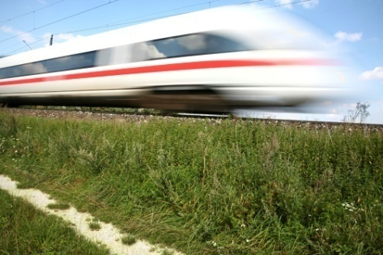
Places and Transportation
D. The names of specific buildings, bridges, monuments, and other landmarks.
Examples: Empire State Building
Mount Rushmore
E. The names of specific airplanes, trains, ships, cars, and spacecraft.
Examples: Air Force One, Volkswagen, Discovery, Cannonball Express

